Slide 1
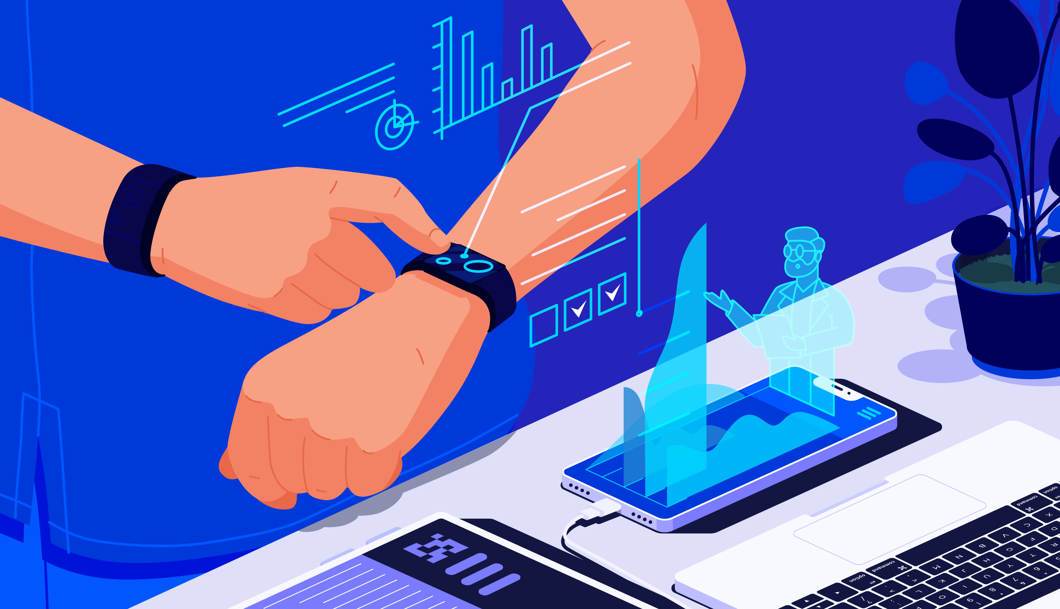
HEALTH MONITORING SYSYTEM
T.ANANTHA SATYA HEMANTH
192110537
CSE-2ND YEAR

Slide 2
CONTENTS
ABSTRACT
HEALTH MONITORING
TYPES OF HEALTH MONITORING SYSTEM
OTHER HEALTH MONITORING SYSYTEMS
HEALTH MONITORING DEVICES
WORKING OF SMART BAND/WATCH
WORKING OF ECG IN SMART BAND
SURVEY
CONCLUSION

Slide 3
ABSTRACT
The increased use of mobile technologies and smart devices in the health zone has brought on extraordinary effect on the world’s critical care.
Health specialists and doctors are using these technologies to create critical change in medicinal services during clinical settings. Likewise, many users are being served from the upsides of the M-Health (Mobile Health) applications and E-Health (social insurance upheld by ICT) to enhance, help and assist their well-being.
The Internet of things is progressively permitting to coordinate gadgets fit for associating with the Internet and give data on the condition of health of patients and give data continuously to specialists who help. The main aim of this ‘Patient Monitoring System’ is to build up a system fit for observing vital body signs, for example, body temperature, heart rate, pulse oximetry.
The System is additionally equipped for fall detection and sleep pattern analysis. To accomplish this, the system involves many sensors to screen fundamental signs that can be interfaced to the doctor’s mobile or the web.
The gadget will exchange the readings from the sensor to cloud remotely and the information gathered will be accessible for analysis progressively. It has the capacity of reading and transmitting emergency signs to the cloud and then to doctor’s web portal or to Doctor’s Smartphone.
These readings can be utilized to recognize the health state of the patient and as an alert system against the emergency health condition. Keywords: IOT, Raspberry pi, AWT cloud, Patient Monitoring

Slide 4
LITTERATURE SURVEY
S. J. Jung and W. Y. Chung (2019)studied the Flexible and scalable patient’s health monitoring system in 6LoWPAN . The main advantage of this enabling factor is the combination of some technologies and communications solution. The results of Internet of Things are synergetic activities gathered in various fields of knowledge like telecommunications, informatics and electronics.
K. S. Shin and M. J. Mao Kaiverstudied(2020) a cell phone based health monitoring system with self analysis which incorporates IoT [13] a new paradigm that uses smart objects which are not only capable of collecting the information from the environment and interacting the physical world, but also to be interconnected with each other through internet to exchange data as well as information.
Gennaro tartarisco and TabiloPaniclo had studied a Maintaining sensing coverage and connectivity in large sensor networks mainly includes the information about how to build or develop a new computational technology based on clinical decision support systems, information processing, wireless communication and also data mining kept in new premises in the field of personal health care.
Cristina Elena Turcua (2019)studied Health care applications a solution based on the Internet of Things survey aims to present a detailed information about how radio frequency identification, multi-agent and Internet of Things technologies can be used to develop and improve people’s access to quality and health care services and to optimize the health care process.
Gubbi, Jayavardhana, Buyya, Rajkumar, Marusic, Slaven, Palaniswami, Marimuth studied the Internet of Things (IoT)(2021): A vision, architectural elements, and future direction which International Journal of Pure and Applied Mathematics Special Issue 60 proposes on demand positioning and tracking system. It is based on Global Positioning enabled devices and suitable for large environments. Smart phones between two terminals are used for making initial communication. The initial communication is performed by synchronization phase

Slide 5
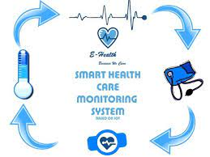

HEALTH MONITORING
System health monitoring is a set of activities undertaken to maintain a system in operable condition and may be limited to an observation of current system states, with maintenance and repair being prompted by these observations.
Monitoring System Description
This paper proposes a model of Patient Health Monitoring System, with different components like fall detection and sleep pattern analysis. The sensors utilized as a part of this project are Accelerometer and Gyroscope (MPU6050), Heart beat sensor, Body temperature sensor, and blood oxygen level (MAX30100), and Proximity sensor (KY032). These sensors work autonomously of each other. The measured reading from the sensor is broke down for the patient and is made accessible to the specialist or to any concerned individual in the type of the web or smart phones. This web interface and additionally versatile application serves as the user

Slide 6
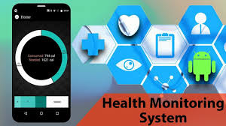
What Does Health Monitoring Mean?
Health monitoring is performed under many different scenarios including in hospitals by nurses and doctors monitoring patients or if a person is injured or exposed to hazardous chemicals they may be monitored. It may also be implemented by an employer to monitor a work environment for occupational or environmental health hazards. With this in mind there will be many different methods that are used for health monitoring and qualifications necessary to be allowed to take part in certain kinds of health monitoring. Health monitoring should always be carried out by a medical practitioner qualified for the task.

Slide 7
TYPES OF HEALTH MONITORING
Patient Monitors.
Capnography.
Vital Signs Monitors.
EKG Machines.
EtCO2 Monitors.
Pulse Oximeters.

Slide 8
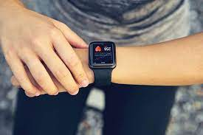
OTHER HEALTH MONITORING SYSYTEMS
WIRE LESS BAND / WATCH
LEG BAND
Smartwatches are the key to knowing everything about your health, your fitness, and your daily activity results. These are basically wearable computers in the form of a watch. The touchscreen interface allows you to track every run and move that you make throughout the day. You can even take this wearable for hiking and other purposes.

Slide 9
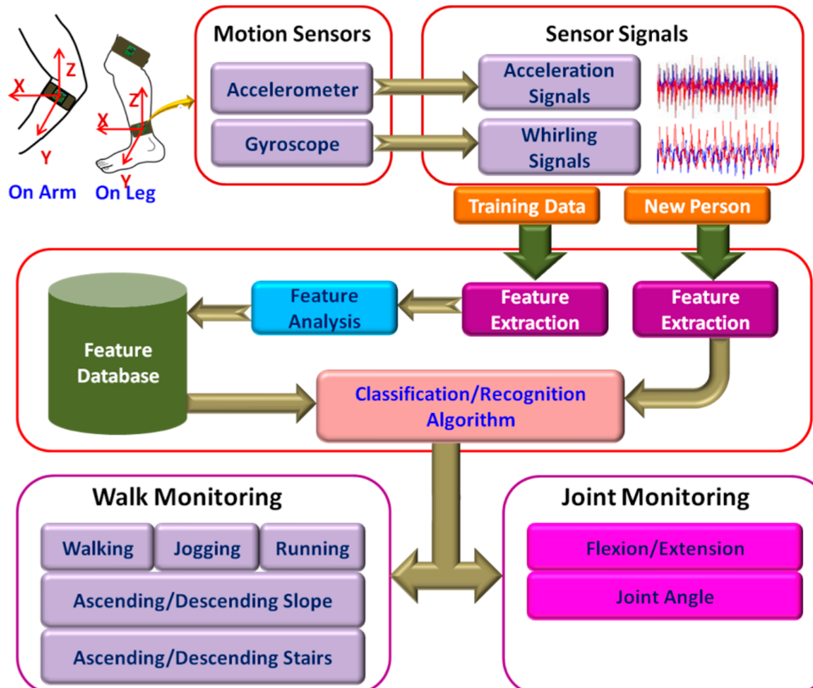
LEG/ARM BAND
This leg/arm band is used
For organization of the activity
That is done in the daily basis.

Slide 10
Working of smart band
In order to monitor health usually, the wearable type smart band module to measure the physiological signals from human body was designed, fabricated and characterized. Smart band module largely consisted of two parts, one was flexible sensors module and the other one was signal processing and communication module. And then two modules were interconnected with Cu wires. Finally, flexible temperature sensor of the fabricated smart band module was tested at the surfaces of ice pack, desk, and hot plate with temperature in the range of 4.5 ∼ 74.1̊C including skin temperature around 30 ∼ 33 ̊C. And GSR data were measured at the skin with high sensitivity and normal atmosphere to compare. Measured data from sensors were signally processed and transmitted using via Bluetooth 4.0 wireless network, so we could display successfully those data using software on the lab-top computer. In the near future, conductive yarns will be used for the interconnections instead of general Cu wires and we are going to measure the emotion change from physiological signals from human body during usual life.

Slide 11
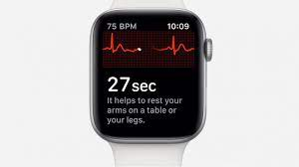
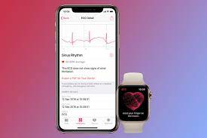
Working of ECG
A single lead electrocardiogram (iECG) can be recorded through a circuit between the detector on the watch back and the digital crown. Rhythm analysis is reported after 30 s of recording and is best done at rest.
The app classifies an iECG as sinus rhythm (SR), AF or inconclusive. Recordings from the watch are saved in PDF format in the Health app . According to publicly-released letters from the FDA, the electrocardiogram (ECG) application has received a de novo FDA clearance with Class II designation for over-the-counter use to determine the presence or absence of AF .
The ECG app is recommended for information only, and consultation with a healthcare professional is recommended prior to taking action. While the feature may be useful for an individual who is feeling symptoms to check his or her rhythm, the information displayed in the app is careful to note to the user that this feature is not intended to rule out a heart attack

Slide 12
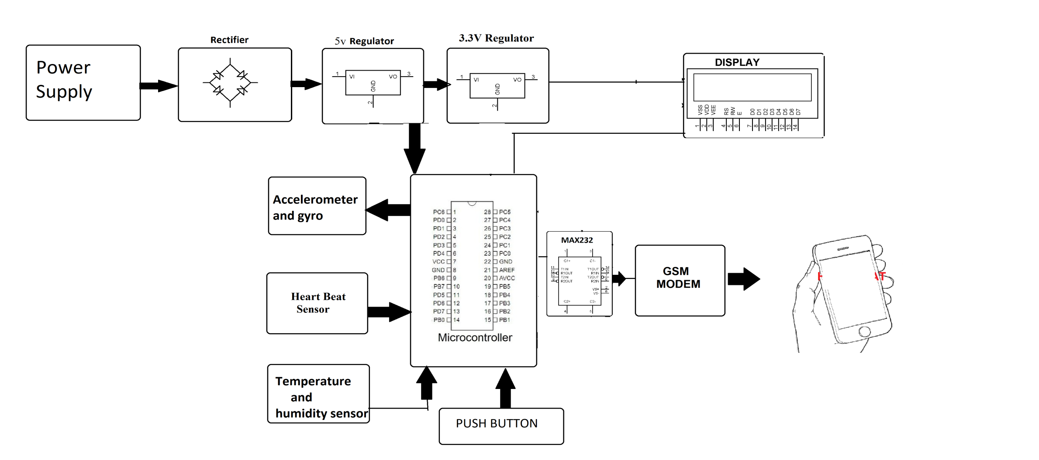
TRACKING OF HEART RATE AND BLOOD PRESURE IN SMART BAND/WATCH
Smartwatch manufacturers use optical rate heart sensors for their smartwatches to monitor the pulse rate and blood pressure more accurately. So yes, smartwatches are able to take accurate blood pressure readings. Smartwatch for blood pressure monitoring is becoming popular in the Indian market for their accuracy and economic prices.

Slide 13
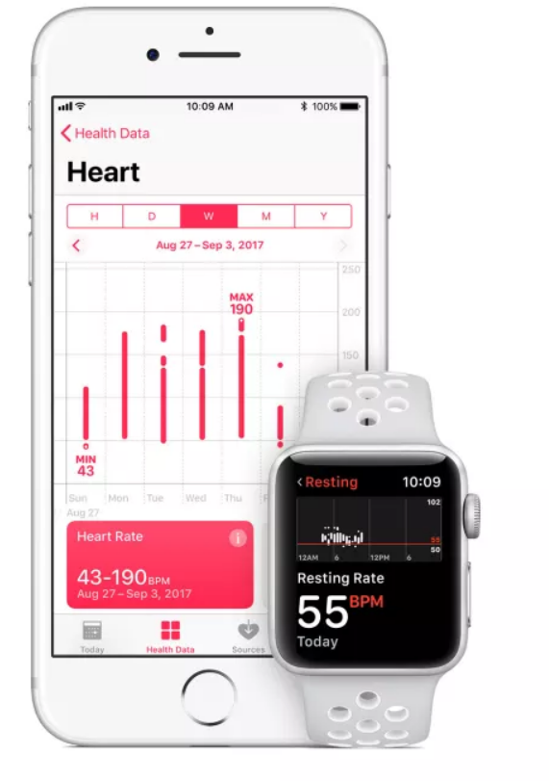
DO THESE SMART WATCHES SAVE LIVES
THE ANSWER IS YES
For example, in October last year Podcast Producer and Reporter James Green from New York wore an Apple Watch(opens in new tab), which prompted him to seek urgent medical attention after it noticed a spike in his resting heart rate. Later he found out it was due to a blood clot in his lungs.

Slide 14
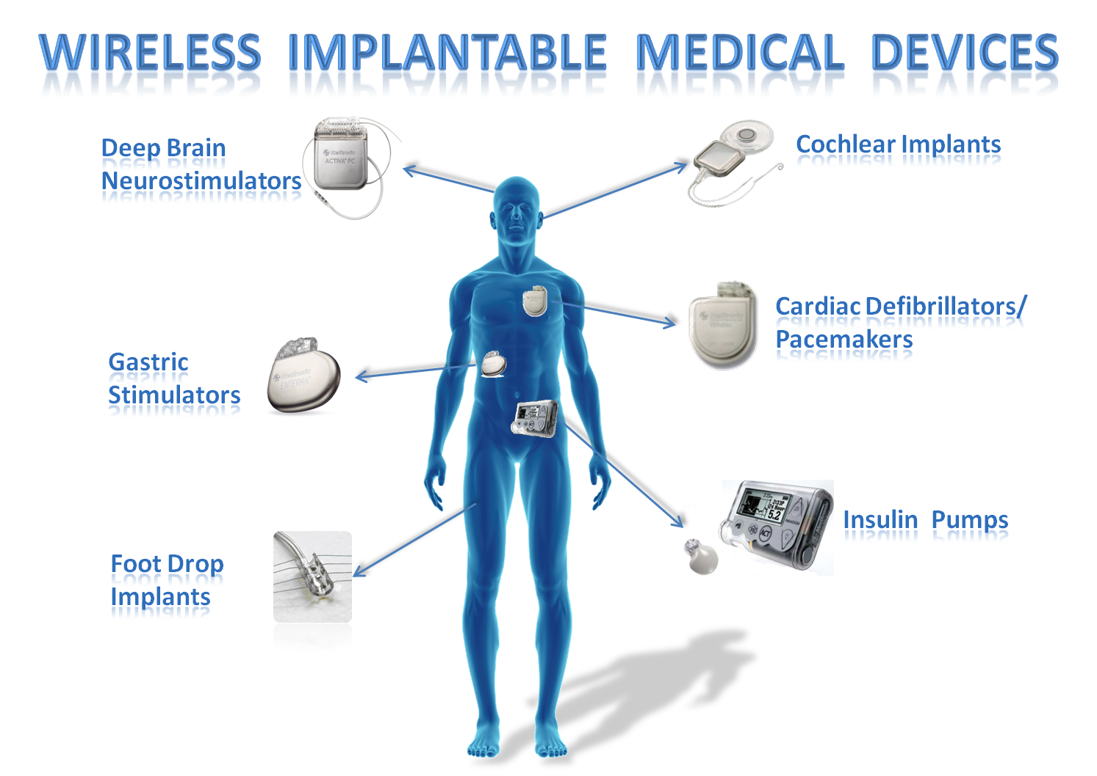
MEDICAL DEVICES WHICH CAN BE INSTALLED IN OUR BODY
DEEP BRAIN NEUROSTIMULATORS
COCHLEAR IMPLANTS
GASTRIC STIMULATOR
CRADIAC DEFIBRILLATORS /PACEMAKERS
FOOT DROP IMPLANTS
INSULIN PUMPS

Slide 15
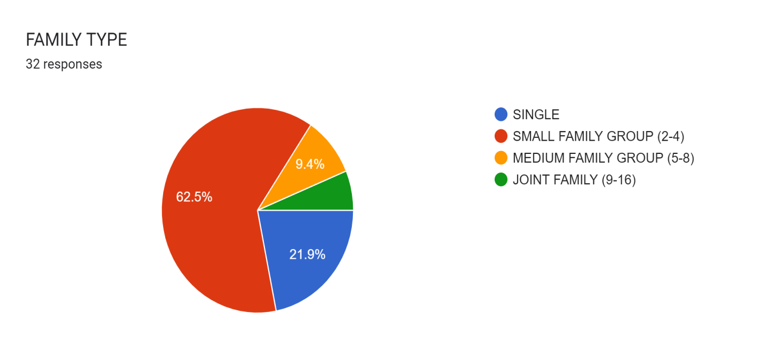
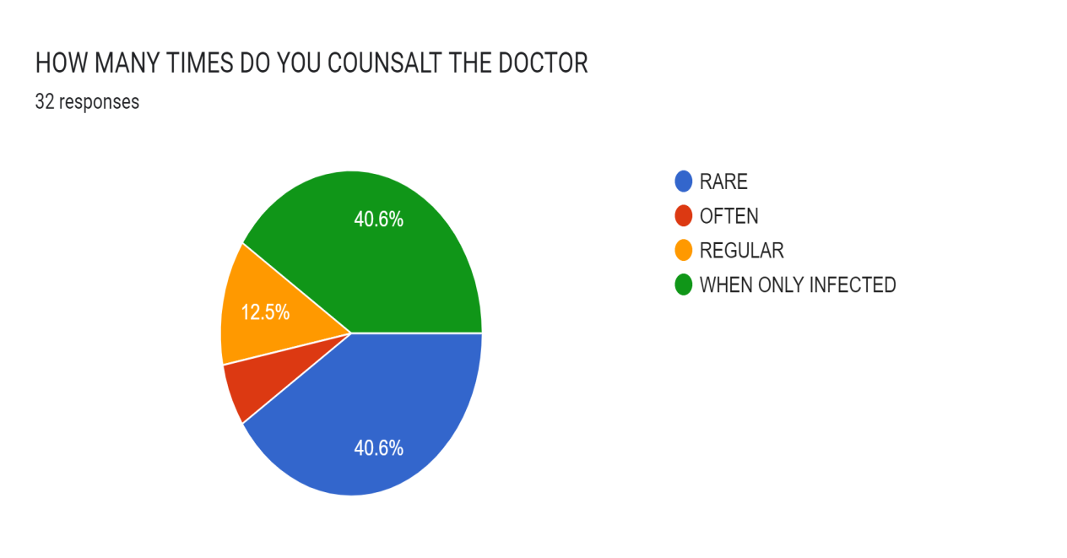
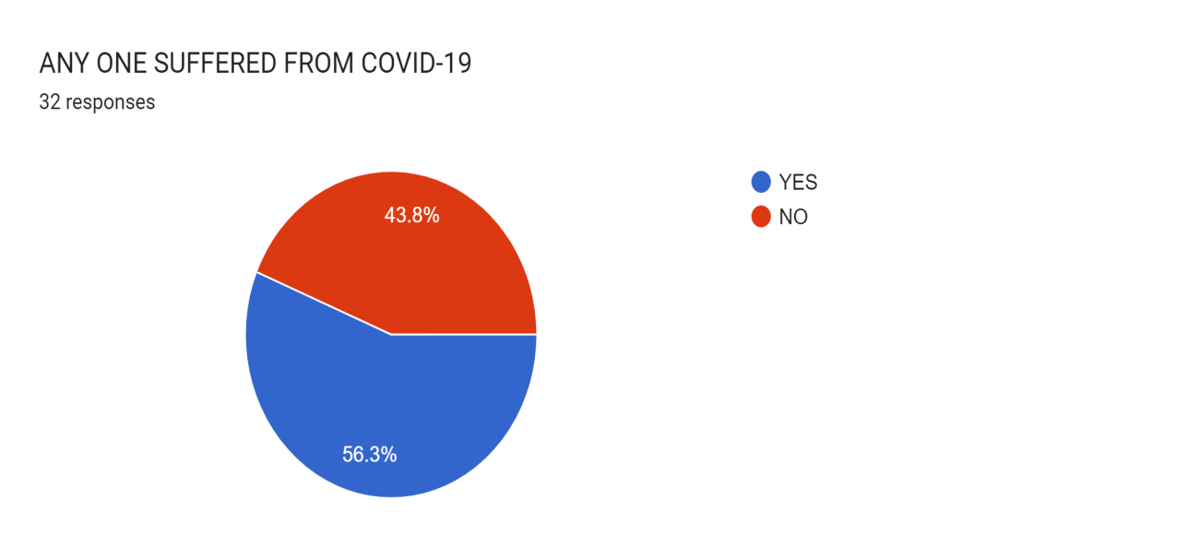
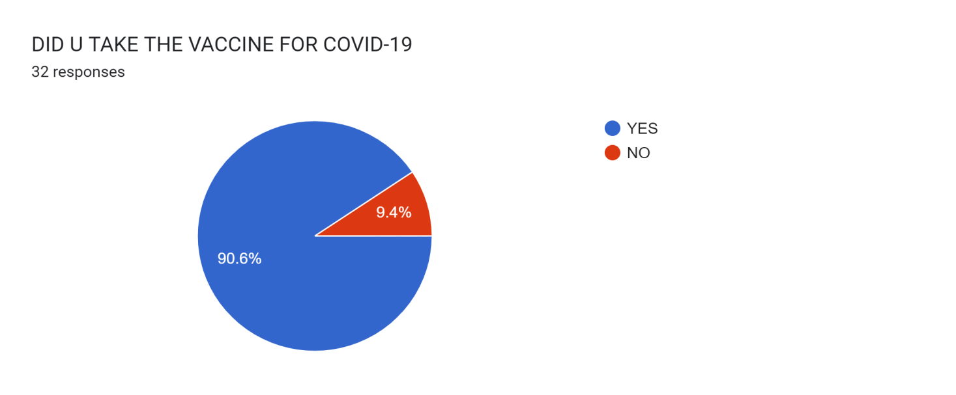
SURVEY BASED ON HEALTH MANGEMENT

Slide 16
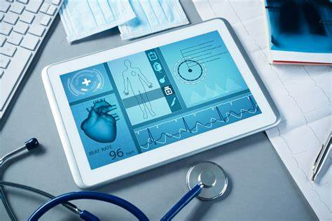
TYPES OF HEALTH MONITORING
As for health monitoring, there are two main ways that technology can make doctors more efficient.
With HMS, there is no need to process a large amount of data manually. The AI-powered system sends an alarm if the patient’s indicators begin to worsen or if there is a predicted threat that things are becoming dangerous. With the help of HMS systems, doctors can save time and effort.
The health monitoring software may also free up more beds in hospitals that can be occupied by patients who need urgent help. After analyzing health indicators with the help of AI, the system may suggest that a certain patient can be discharged and recover at home while receiving medical advice remotely. This allows doctors to focus on people whose lives are in danger.
Also, the HMS can help patients recover after surgery or heart attacks while staying at home and in touch with a doctor. Even if the patient is your pet.

Slide 17
5 REASONS TO BUILD AN HMS
Here are the main advantages of a health monitoring system and the great reasons to develop it for your hospital to transform it into a Smart Hospital.
Real-time health monitoring systems using IoT can help doctors prioritize patients, and provide urgent care to those who are in the most danger thereby saving lives.
More competent patient management can help utilize the resources of the hospital more wisely and save money.
It is easy to use the system for patients and medical professionals.
The remote health monitoring system is especially useful to monitor patients with chronic diseases. Most chronic diseases are incurable, so it is necessary to monitor the state of the patient while at home, and quickly respond if health indicators worsen.
The HMS is convenient and portable so it is very convenient for doctors to manage patients from one app, and it is also very easy for patients to monitor their own health by wearing a lightweight device like a bracelet.

Slide 18
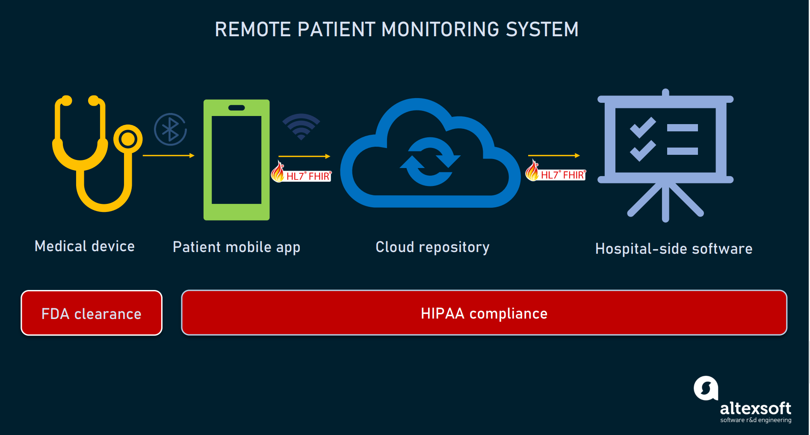
Data Security is the Main Issue .
Medical data is one of the most expensive types of information available on the black market. It costs even more to obtain than personal financial information. Hackers and fraudsters can sell medical data to obtain drugs or for blackmail purposes. That is why the issue of data cybersecurity is paramount when it comes to health monitoring system development.
Currently, the safest way to protect medical data is to employ blockchain technology. Blockchain, the Internet of Things (IoT), and Artificial intelligence form the strongest combination possible, with blockchain responsible for data safety, IoT for fast data transfer from wearable devices, and AI for accurate data analysis and predictive analytics.

Slide 19
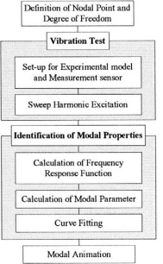
The health monitoring system is employed as the method to measure the observation data. The experimental modal analysis is one of the effective health monitoring systems for the case where the modal parameters such as natural frequencies are adopted as the observations.
In this study, the experimental modal analysis was used to measure the natural frequencies as the observations. The experimental modal analysis system consists of the measurements of transfer functions obtained by vibration tests and the identification of modal parameters. Flow on a series of the experimental modal analysis is shown in Fig. 3. Sweep harmonic excitation method was used as the vibration tests in the health monitoring system. A ring gage is used to measure the excitation forces as input data. And accelerations on each unit are measured as the response datA

Slide 20
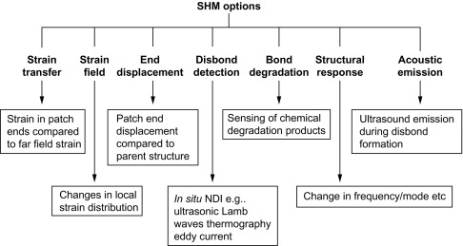

Slide 21
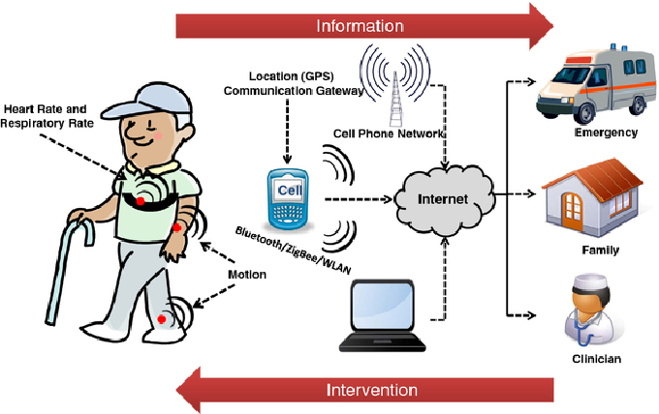
WAY MORE HELP FULL FOR OLD PEOPLE

Slide 22
CONCLUSION
Such innovation does not come cheap. However, it is possible to find an affordable way to budget for your health monitoring system project development. The best thing to do is contact a vendor who already has experience with medical projects and can find ways to develop only the features that are must-haves for your medical practice or business.
Linking it to the subject:
Here based on my topic I would link the subject to POM as this is the

Slide 23


